Slide 1
Use of the wavelet transform on hydro-meteorological data

Slide 2
Abstract
Wavelets are mathematical functions that cut up data into different frequency components, and then study each component with a resolution matched to its scale. They have advantages over traditional Fourier methods in analyzing physical situations where the signal contains discontinuities and sharp spikes. Wavelets were developed independently in the fields of mathematics, quantum physics, electrical engineering, and seismic geology. Interchanges between these fields during the last ten years have led to many new wavelet applications such as image compression, turbulence, human vision, radar, and earthquake prediction.

Slide 3
introduction
The fundamental idea behind wavelets is to analyze according to scale. Indeed, some researchers in the wavelet field feel that, by using wavelets, one is adopting a whole new mindset or perspective in processing data. Wavelets are functions that satisfy certain mathematical requirements and are used in representing data or other functions. This idea is not new. Approximation using superposition of functions has existed since the early 1800’s, when Joseph Fourier discovered that he could superpose sines and cosines to represent other functions. However, in wavelet analysis, the scale that we use to look at data plays a special role. Wavelet algorithms process data at different scales or resolutions.

Slide 4
In this study, the wavelet transforms have been collectively employed to estimate the daily precipitation of Kamchatka meteorological data throughout the region. Application is presented for daily precipitation estimation using wavelet sub-series of the various meteorological variables. I get data from the site http://mgr.imces.ru/stdpub/mgr-kamchatka/kf_gs_ras
List of files are depicted in figure 1.

Slide 5
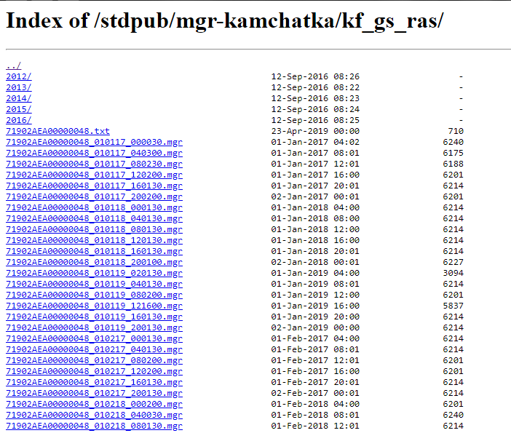
Figure 1. List of files

Slide 6
Meteorological time series covering the interval between January 2017 and December 2018—a period of 365 days (1 year)—were provided by DMI (Kamchatka State Meteorological services) for 12 meteorological stations distributed throughout Kamchatka. The meteorological time series for daily mean temperature (Tmean), daily maximum temperature (Tmax), daily minimum temperature (Tmin), daily total specific humidity (H), daily total evaporation (E), and daily total precipitation (P) were used in the study. Yearly values of the hydro-climatic variables in the period 2017–2018 are depicted in Figure 2.

Slide 7
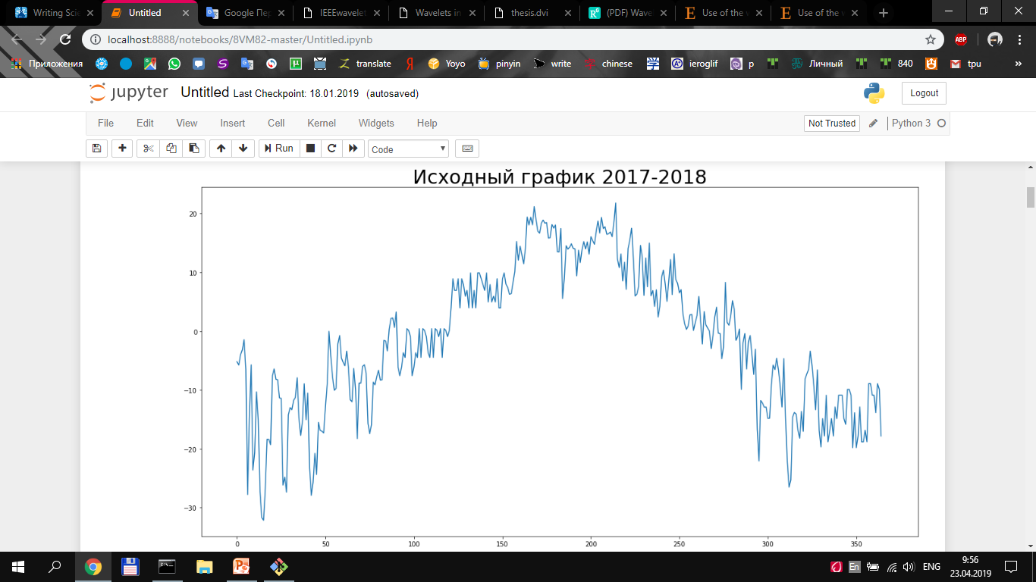
Figure 2. Yearly values of the hydro-climatic variables

Slide 8
Wavelet analysis of hydro-meteorological data
For the subject of this study, the continuous wavelet spectrum and GWS of the data were researched. The Morlet wavelet was used as the main wavelet function. The effective periodic events are seen as light regions on the continuous wavelet spectrum (CWS) and peaks of the GWS. The CWS and GWS of the monthly evaporation data are shown in Figure 3. The dominance of the annual cycle (12 months) is evident in the GWS and the CWS of the data.

Slide 9

Wavelet analysis
The wavelet transform is a powerful mathematical tool that provides a time–frequency representation of an analysed signal (Daubechies, 1990). Wavelet transform analysis, developed during the last two decades, appears to be a more effective tool than the Fourier transform (FT) in studying non-stationary time series (Drago & Boxall, 2002). Assuming a continuous time series x(t ), t ∈ [∞, –∞], a wavelet function ψ(η) that depends on a non-dimensional time parameter η can be written as ψ(η) = ψ($r ,s)=sA=s^{−1/2}$ ψ $(\frac{t−r}{s})$ , (1) where t stands for time; τ for the time step in which the window function is iterated; s ∈ [0, ∞] for the wavelet scale. The term ψ(η) must have zero mean and be localized in both the time and the Fourier space (Meyer, 1993).

Slide 10
from scipy import signal
import matplotlib.pyplot as plt
widths = np.arange(1, 61)
cwtmatr = signal.cwt(sst, signal.ricker, widths)
fig = plt.figure(figsize=(18, 10))
ax.set_xlabel('(degC)')
plt.plot(cwtmatr[0])
plt.plot(cwtmatr[1])
plt.plot(cwtmatr[2])
plt.plot(cwtmatr[3])
plt.xlabel('Дни', fontsize=20)
plt.ylabel('Амплитуда', fontsize=20)
plt.title('Рассчитанные значения интегралов функции для каждого масштаба в каждый момент времени', fontsize=20)

Slide 11
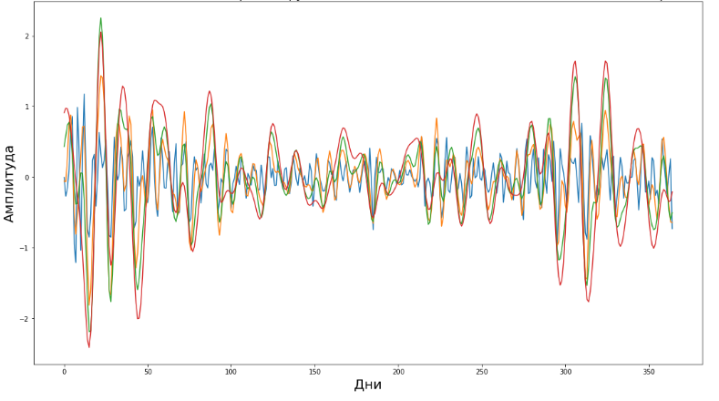
Figure 3. Yearly precipitation estimation by Morlet wavelet

Slide 12
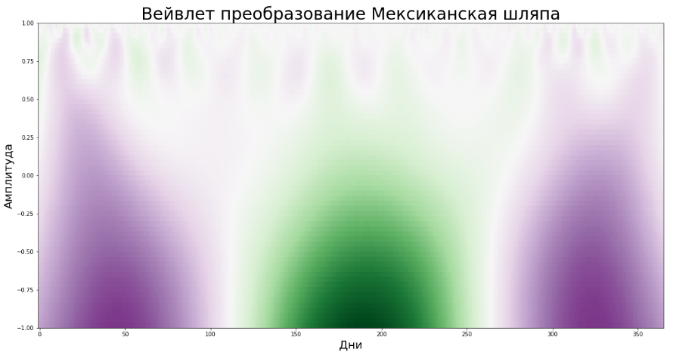
fig = plt.figure(figsize=(20, 10))
plt.title('Вейвлет преобразование Мексиканская шляпа', fontsize=30)
plt.imshow(cwtmatr, extent=[-1, 365,-1,1], cmap='PRGn', aspect='auto', vmax=abs(cwtmatr).max(), vmin=-abs(cwtmatr).max())
plt.xlabel('Дни', fontsize=20)
plt.ylabel('Амплитуда', fontsize=20) plt.show()
Figure 4. Mexican hat wavelet

Slide 13
plt.figure(figsize=(25,15))
ax = fig.add_subplot(111, projection='3d')
x = np.linspace(0,365,365)
y = np.arange(60)
X,Y = np.meshgrid(x,y)
Z = np.zeros((len(y),len(x)))
for i in range(len(y)):
Z[i] = cwtmatr[i]
ax.plot_surface(X, Y, Z, rstride=1, cstride=5, cmap='seismic', alpha=1, linewidth=0, antialiased=True, shade=False, lw=20)
plt.title('Вейвлет преобразование Мексиканская шляпа', fontsize=30)
ax.set_zlabel("Амплитуда", fontsize=20)
ax.set_xlabel("Дни", fontsize=20)
ax.set_ylabel("Масштаб", fontsize=20)
ax.view_init(20,-120)
plt.show()

Slide 14
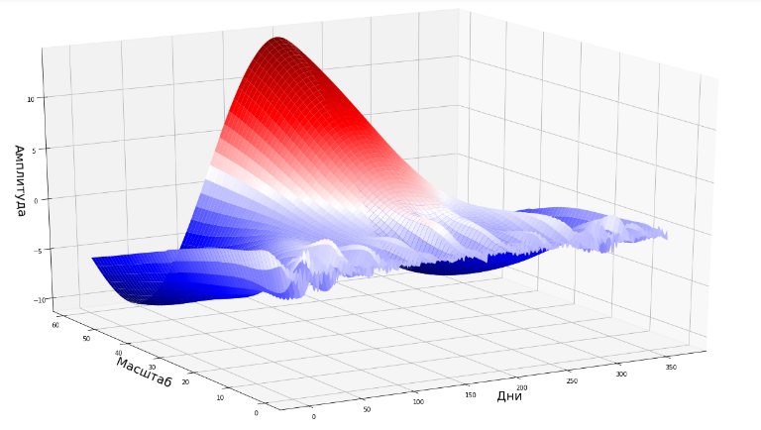
Figure 5. 3D Mexican hat wavelet

